Slide 1
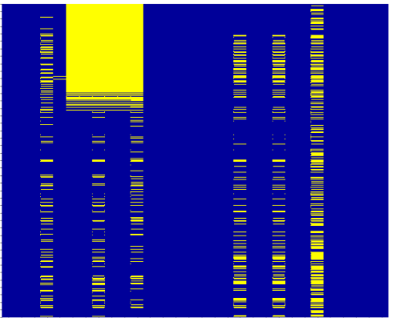
Data Report
#Columns | 5000
#Rows | 25136547
#Missing rate | 25%
#Empty Columns | 242
#Duplicated header | 3
#Single value Column | 4
#Column with missing data | 234
#Duplicated rows | 23
#Incomplete rows | 98
#Columns with same value | 12
User action
Quality Issue |  | Keep | Remove
Duplicate headers | Column J |  | •
 | Column K | •
 | Column X |  | •
Single Value Column | Column A |  | •
 | Column B |  | •
 | Column C |  | •
Missing data | Column D (45%) |  | •
 | Column X (55%) |  | •
 | Column F (10%) |  | •
Columns with same value | Col M |  | •
 | Col N | •
 | Col O |  | •
Duplicated rows | Total rows |  | •
Incomplete rows | Total rows |  | •
Data Map
Column with same headers
Has value
Miss rate scale
Empty
Start Cleansing
Output csv file.

